Slide 1
SDLC Models

Slide 2
Software Development Life Cycle Models
A software life cycle model (also called process model) is a descriptive and diagrammatic representation of the software life cycle. A life cycle model represents all the activities required to make a software product transit through its life cycle phases. It also captures the order in which these activities are to be undertaken.
Different life cycle models may map the basic development activities in different ways.
Thus, no matter which life cycle model is followed, the basic activities are included in all life cycle models though the activities may be carried out in different orders in different life cycle models

Slide 3
Why following a model…
Without using of a particular life cycle model the development of a software product would not be in a systematic and disciplined manner.
When a software product is being developed by a team there must be a clear understanding among team members about
what to do and
when to do
Not following = chaos and project failure.

Slide 4
SDLC Models
Water Fall Model
The Incremental model
Spiral Model
Agile Model

Slide 5
Waterfall model
Waterfall model phases
Requirements analysis and definition:
– Develop understanding of problem domain, user needs, function, performance, interfaces.
– Multi-step process to determine architecture, interfaces, data structures, functional detail. Produces (high-level) form that can be checked for quality, conformance before coding.

Slide 6
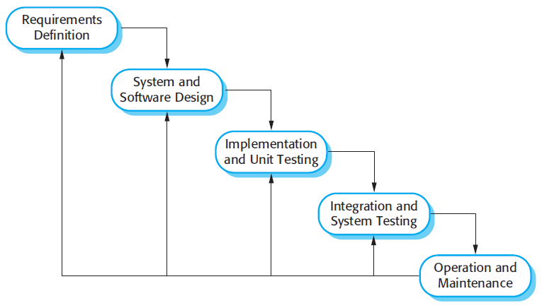
Waterfall model

Slide 7
Waterfall model
System and software design:
-The systems design process partitions the requirements to either hardware or software systems.
-It establishes overall system architecture.
- Software design involves identifying and describing the fundamental software system abstractions and their relationships.
Coding :
– Produce machine readable and executable form, match HW, OS and design needs.

Slide 8
Waterfall model
Integration and system testing:
– Confirm that components, subsystems and complete products meet requirements, specifications and quality, find and fix defects.
Operation and maintenance: Normally (although not necessarily) this is the longest life-cycle phase. The system is installed and put into practical use.
Maintenance: Incrementally, evolve software to fix defects, add features, adapt to new condition. Often 80% of effort spent here!

Slide 9
Advantage & Disadvantage of Waterfall model
Advantages:
The waterfall model are that documentation is produced at each phase and that it fits with other engineering process models.
Disciplined approach
Careful checking by the Software Quality Assurance Group at the end of each phase.(or Testing in each phase.)
Documentation available at the end of each phase
Linear model..
Easy to understand and implement.
Identifies deliverables and milestones

Slide 10
Advantage & Disadvantage of Waterfall model
Disadvantage:
The waterfall model is the difficulty of accommodating change after the process is underway. One phase has to be complete before moving onto the next phase.
Unidirectional
Unclear requirements lead to confusion.
Client’s approval is in the final stage.
Difficult to integrate risk management
Idealized, doesn’t match reality well.
Doesn’t reflect iterative nature of exploratory development

Slide 11
The Incremental model
Construct a partial implementation of a total system
Then slowly add increased functionality
The incremental model prioritizes requirements of the system and then implements them in groups.
Each subsequence release of the system adds function to the previous release, until all designed functionality has been implemented.

Slide 12
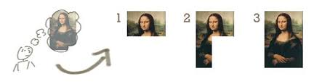
The Incremental model

Slide 13
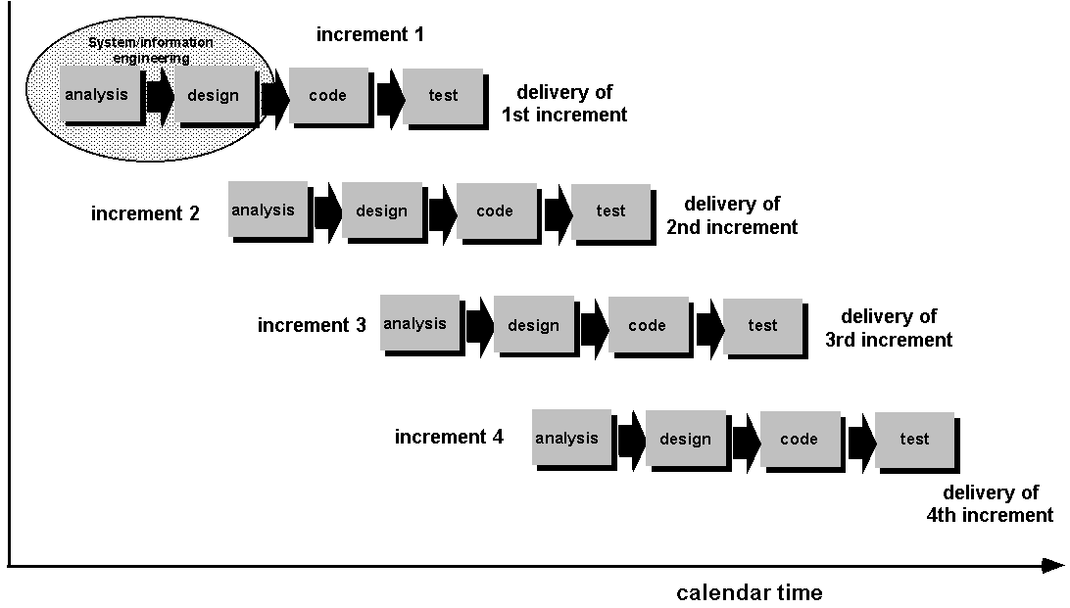
The Incremental model

Slide 14
Advantages of The Incremental model
Develop high risk or major function first.
Each release delivers an operational product.
Customer can respond to each build.
Uses “divide and Conquer” break down of task.
Lower initial delivery cost.
Initial product delivery is faster.
Customers get important functionality early.
Risk of changing requirements is reduced.

Slide 15
Disadvantages of The Incremental model
Require good planning and design.
Requires early definition of a complete and fully functional system to allow for the definition of increments.
Well-defined module interfaces are required.
Total cost of complete system is not lower.

Slide 16
When to use Incremental Model
Risk, funding, schedule, program complexity, or need for early realization of benefits.
Most of the requirements are known up-front but are expected to evolve over time.
A need to get basic functionality to the market early.
On projects which have lengthy development schedules.
On a project with new technology.
Mostly such model is used in web applications and product based companies.

Slide 17
Spiral Model
Spiral model is a combination of iterative development process model and sequential linear development model i.e. waterfall model with very high emphasis on risk analysis.
It allows for incremental releases of the product, or incremental refinement through each iteration around the spiral.

Slide 18
Spiral Model
Each trip around the spiral traverses four basic quadrants:
-determine objectives, alternatives, and constraints of the iteration;
-evaluate alternatives; Identify and resolve risks;
-develop and verify deliverables from the iteration;
-plan the next iteration.
Begin each cycle with an identification of stakeholders and their "win conditions", and end each cycle with review and commitment.

Slide 19
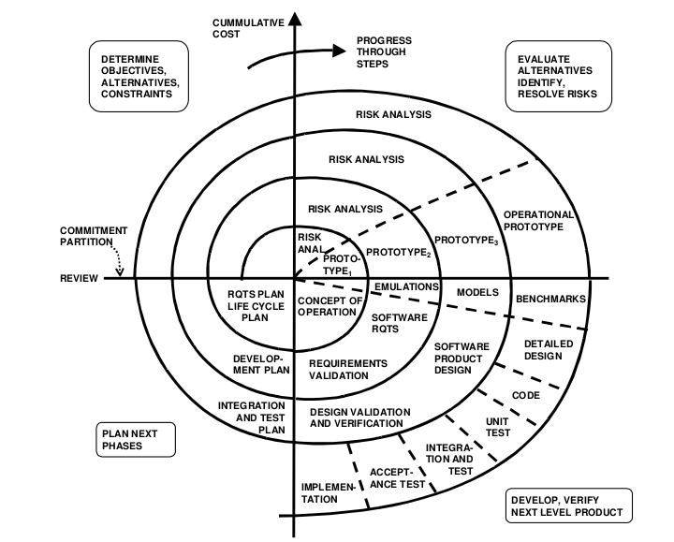

Slide 20
Spiral Model
First quadrant (Determine Objectives)
-During the first quadrant, it is needed to identify the objectives of the phase.
-Examine the risks associated with these objectives.
Second Quadrant (Identify and Resolve Risk)
-A detailed analysis is carried out for each identified project risk.
-Steps are taken to reduce the risks. For example, if there is a risk that the requirements are inappropriate, a prototype system may be developed

Slide 21
Spiral Model
Third Quadrant (Development and Testing)
-Develop and validate the next level of the product after resolving the identified risks.
Fourth Quadrant (Review and Planning of next Iteration)
-Review the results achieved so far with the customer and plan the next iteration around the spiral.
-Progressively more complete version of the software gets built with each iteration around the spiral.

Slide 22
Advantages of using Spiral Model:
Larger projects / software are created and handled in a strategic way.
Risk evaluation is proper.
More and more features are added in a systematic way.
Software is produced early.
Has room for customer feedback and the changes are implemented faster.

Slide 23
Disadvantages of using Spiral model:
Risk analysis is important phase so requires expert people.
Not suitable for small or low risk projects and could be expensive for small projects.
Spiral may go infinitely.
Large number of intermediate stages requires excessive documentation.

Slide 24
When to Use?
When there is a budget constraint and risk evaluation is important.
For medium to high-risk projects.
Long-term project commitment because of potential changes as the requirements change with time.
Customer is not sure of their requirements.
Requirements are complex and need evaluation to get clarity.
Significant changes are expected in the product during the development cycle.

Slide 25
Agile Model
Agile SDLC model is a combination of iterative and incremental process models with focus on process adaptability and customer satisfaction by rapid delivery of working software product.
Agile Methods break the product into small incremental builds. These builds are provided in iterations.
Each iteration typically lasts from about one to three weeks. Every iteration involves cross functional teams working simultaneously on various areas like planning, requirements analysis, design, coding, unit testing, and acceptance testing.
At the end of the iteration a working product is displayed to the customer and important stakeholders.

Slide 26
Agility Principles
There are 12 agility principles for those who want to achieve agility:
1. Our highest priority is to satisfy the customer through early and continuous delivery of valuable software.
2. Welcome changing requirements, even late in development.
3. Deliver working software frequently, from a couple of weeks to a couple of months, with a preference to the shorter timescale.
4. Business people and developers must work together daily throughout the project.

Slide 27
Agility Principles
5. Build projects around motivated individuals. Give them the environment and support they need, and trust them to get the job done.
6. The most efficient and effective method of conveying information to and within a development team is face-to-face conversation.
7. Working software is the primary measure of progress.
8. Agile processes promote sustainable development. The sponsors, developers, and users should be able to maintain a constant pace indefinitely.

Slide 28
Agility Principles
9. Continuous attention to technical excellence and good design enhances agility.
10. Simplicity—the art of maximizing the amount of work not done—is essential.
11. The best architectures, requirements, and designs emerge from self– organizing teams.
12. At regular intervals, the team reflects on how to become more effective, then tunes and adjusts its behavior accordingly.

Slide 29
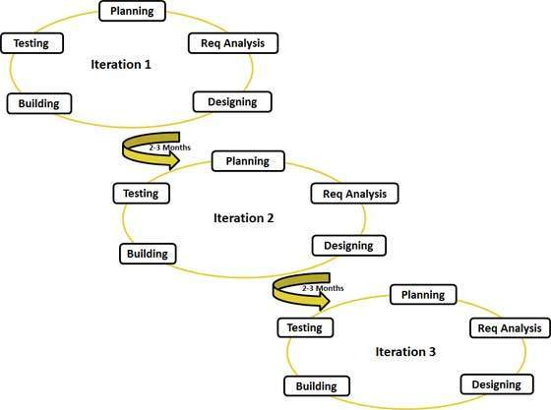
Agility Diagram

Slide 30
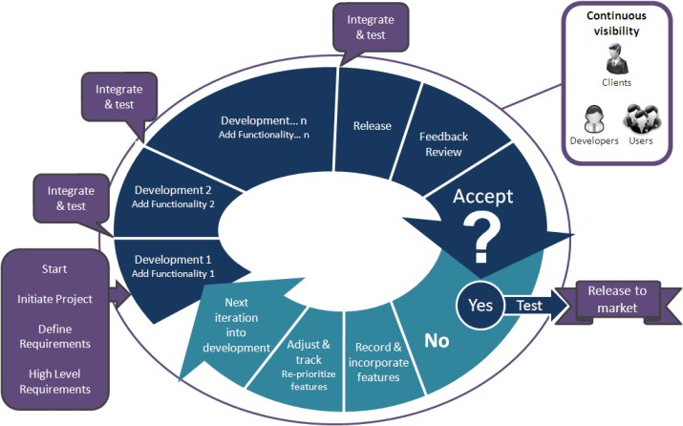

Slide 31
Advantages of Agile model:
Customer satisfaction by rapid, continuous delivery of useful software.
People and interactions are emphasized rather than process and tools. Customers, developers and testers constantly interact with each other.
Working software is delivered frequently (weeks rather than months).
Face-to-face conversation is the best form of communication.
Regular adaptation to changing circumstances.

Slide 32
Disadvantages of Agile model:
In case of some large software deliverables, it is difficult to assess the effort required at the beginning of the software development life cycle.
There is lack of emphasis on necessary designing and documentation.
The project can easily get taken off track if the customer representative is not clear what final outcome that they want.
Only senior programmers are capable of taking the kind of decisions required during the development process. Hence it has no place for newbie programmers

Slide 33
When to use Agile model
When new changes are needed to be implemented.. New changes can be implemented at very little cost because of the frequency of new increments that are produced.
To implement a new feature the developers need to lose only the work of a few days, or even only hours, to roll back and implement it.
Unlike the waterfall model, in agile model very limited planning is required to get started with the project. Agile assumes that the end users’ needs are ever changing in a dynamic business and IT world.

Slide 34
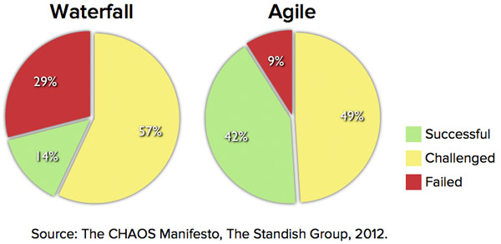
Waterfall VS Agile

Slide 35
Waterfall VS Agile
Suppose Google is working on project to come up with a competing product for MS Word:
That provides all the features provided by MS Word and any other features requested by the marketing team.
The final product needs to be ready in 10 months of time.
Let us see how this project is executed in traditional and Agile methodologies.

Slide 36
In traditional Waterfall model –
At a high level, the project teams would spend 15% of their time on gathering requirements and analysis (1.5 months)
20% of their time on design (2 months)
40% on coding (4 months) and unit testing
20% on System and Integration testing (2 months).
At the end of this cycle, the project may also have 2 weeks of User Acceptance testing by marketing teams.
In this approach, the customer does not get to see the end product until the end of the project, when it becomes too late to make significant changes.

Slide 37
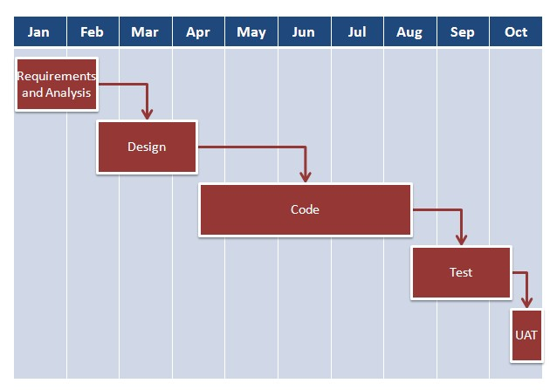
Project Schedule in Waterfall Model

Slide 38
With Agile development methodology –
In the Agile approach, each project is broken up into several ‘Iterations’.
All Iterations should be of the same time duration (between 2 to 8 weeks).
At the end of each iteration, a working product should be delivered.
In simple terms, in the Agile approach the project will be broken up into 10.
Rather than spending 1.5 months on requirements gathering, in Agile software development, the team will decide the basic core features.

Slide 39
With Agile development methodology –
Any remaining features that cannot be delivered in the first iteration will be taken up in the next iteration or subsequent iterations, based on priority.
At the end of the first iterations, the team will deliver a working software with the features that were finalized for that iteration.
There will be 10 iterations and at the end of each iteration the customer is delivered a working software that is incrementally enhanced and updated with the features that were shortlisted for that iteration.

Slide 40
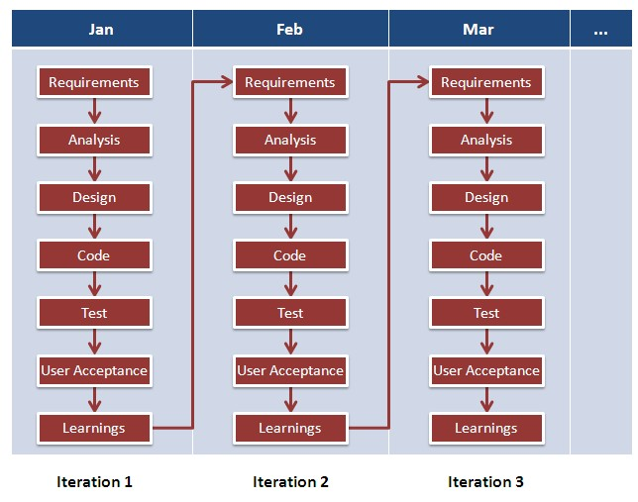
Project Schedule in Agile Model

Slide 41
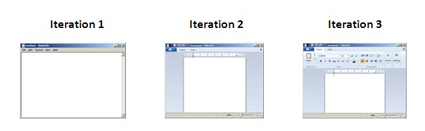
Software evolve through Iteration

Slide 42
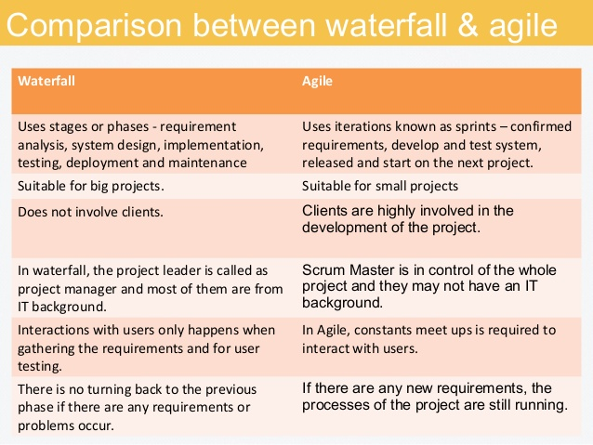

Slide 43
Assignment1
Scrum
Agile XP(Extreme Programming)

